Slide 1
Neuro-Oncology Tumor Segmentation
“Using Deep Learning for Accurate Tumor segmentation”

Slide 2

Why This Project?
Solving Real-World Problems: Addressing critical healthcare challenges.
Brain Tumors: Life-threatening, requiring precise treatment planning.
Early Detection: Key to improving patient outcomes.
Manual Segmentation: Time-consuming and prone to errors.
Automated Methods: Enhancing accuracy and efficiency in diagnosis.

Slide 3
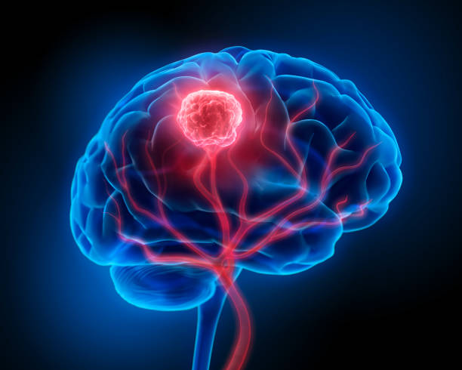
What is Brain Tumor
Brain tumor: Abnormal Growth of cells.
Types of Brain Tumors:
Benign Tumors: Non-cancerous, slower growth.
Malignant Tumors: Cancerous, aggressive, and life-threatening.

Slide 4
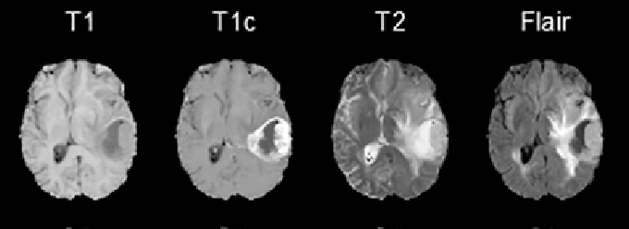
MRI Modalities

Slide 5
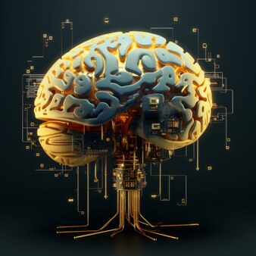
Data
MRI Modalities Used:
T1, T1CE, T2, and FLAIR scans for comprehensive tumor imaging.
Dataset Details:
Source: MICCAI Brain Tumor Segmentation (BraTS) Challenge 2021
Size: 42 GB, 369 cases
Structure:
Each case includes 4 modalities (T1, T1CE, T2, FLAIR).
Each modality is a 3D volume with dimensions:
Depth: 155 slices
Height and Width: 240x240 pixels

Slide 6
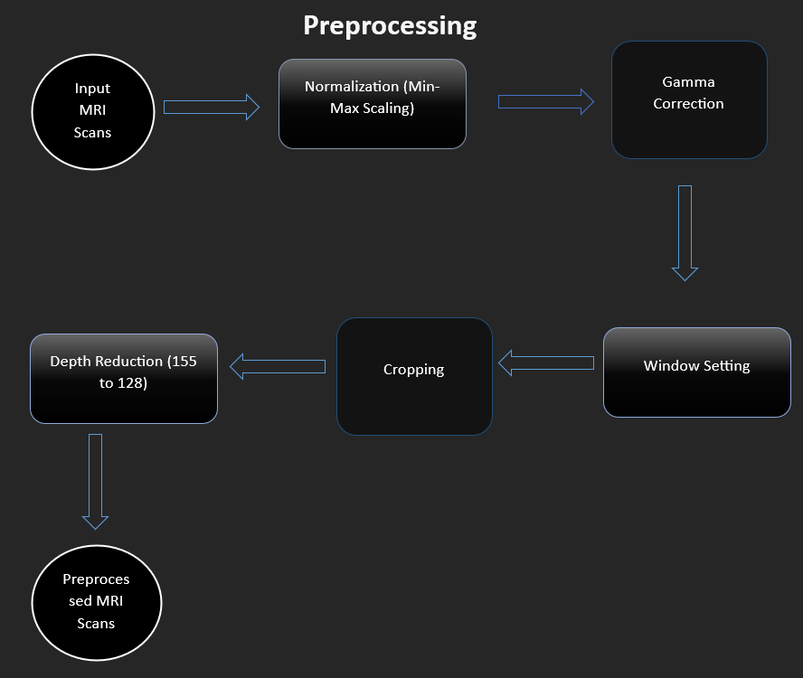
Preprocessing
Normalization: Min-Max scaling.
Gamma Correction: Enhances contrast.
Window Setting: Focuses on relevant intensity ranges.
Cropping: Removes non-informative edges.
Depth Reduction: Reduced depth from 155 to 128 (removed 15 slices at start, 12 at end).

Slide 7
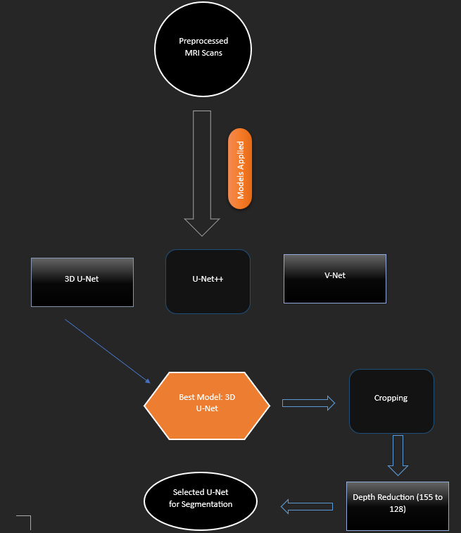
Models Applied
Deep Learning Models Used:
3D U-Net
U-Net++
V-Net
Testing Results:
Tested all models; U-Net showed the best performance.
Selected U-Net for final segmentation tasks due to its efficiency and accuracy.

Slide 8
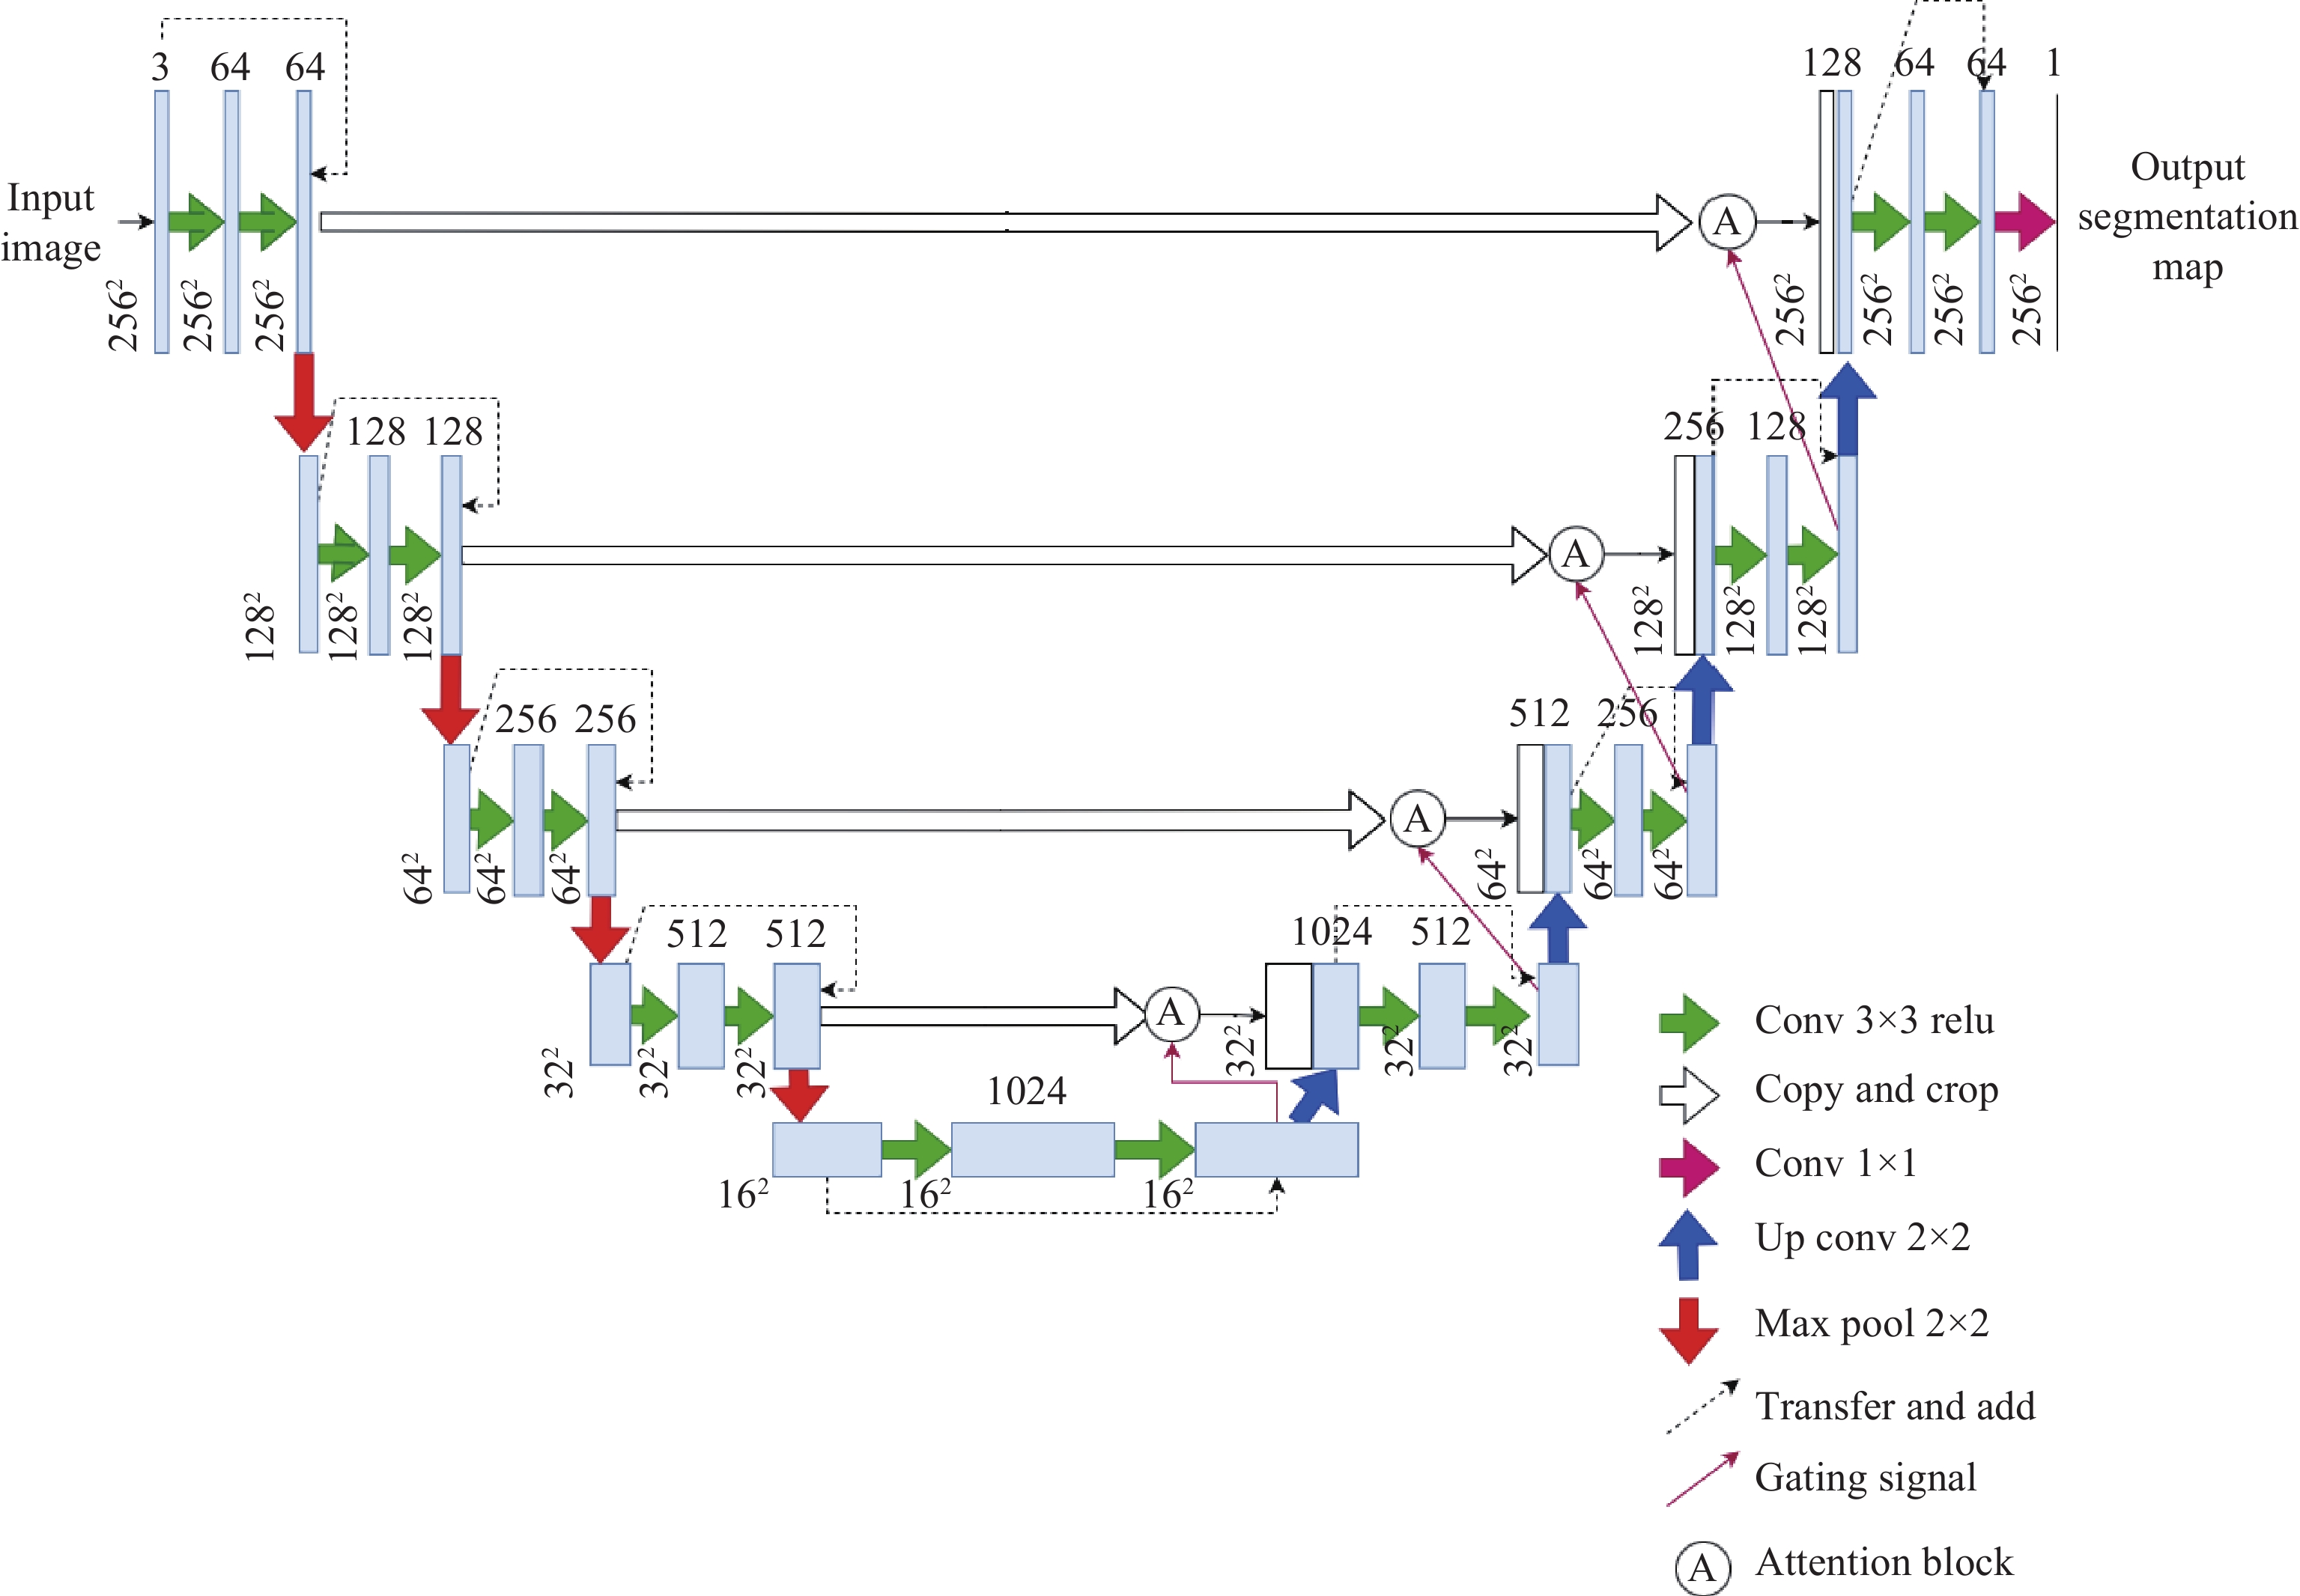
Why 3D-UNet
Encoder-Decoder Structure: Symmetric architecture with contracting (encoder) and expanding (decoder) paths.
3D Convolutions: Operates on volumetric data for spatial context in all dimensions.
Skip Connections: Direct links between encoder and decoder layers to preserve spatial details.
Pooling and Upsampling: Downsampling via max-pooling; upsampling with transposed convolutions.
Feature Maps: Extracts hierarchical features at different scales.
Output: Final layer produces voxel-wise tumor segmentation.

Slide 9
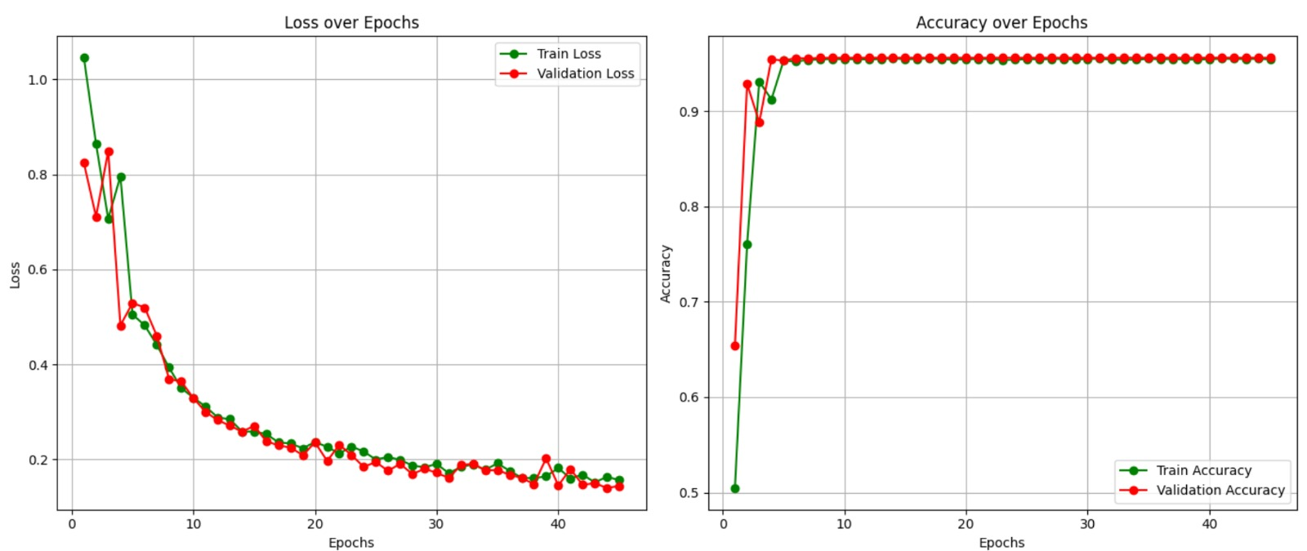
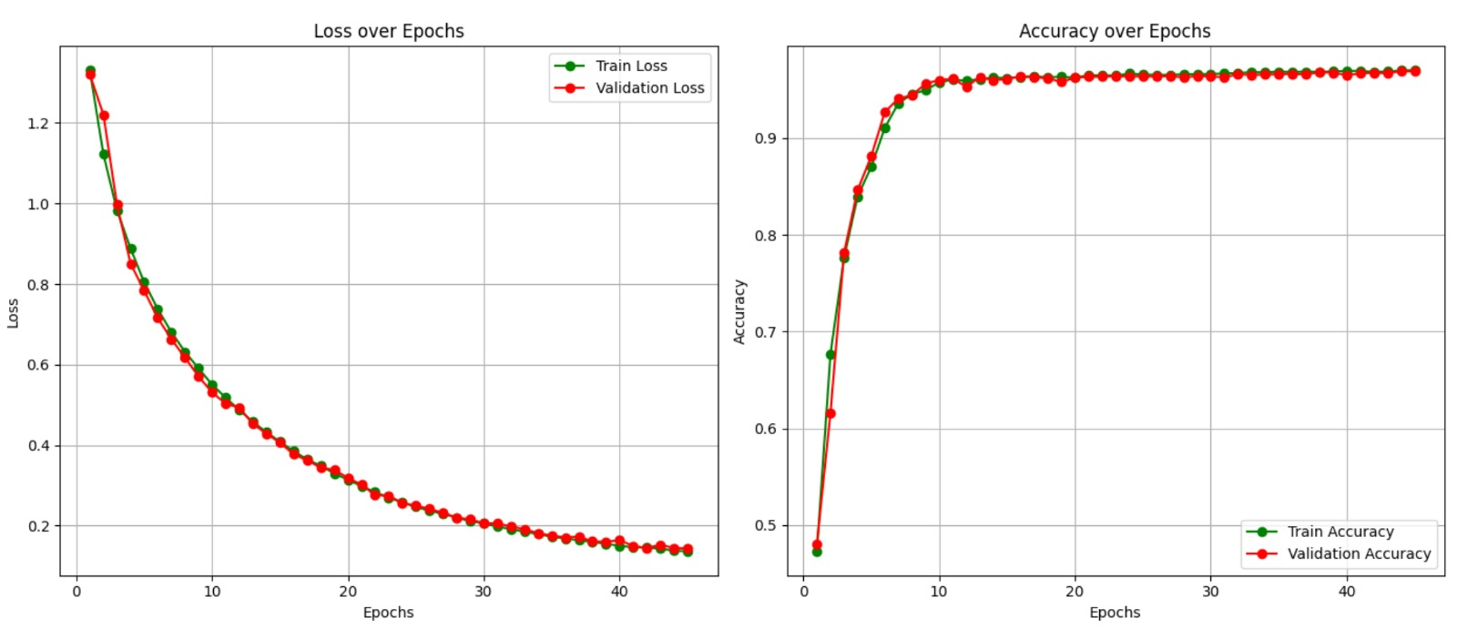
V-Net V/s 3D-UNet
hg

Slide 10
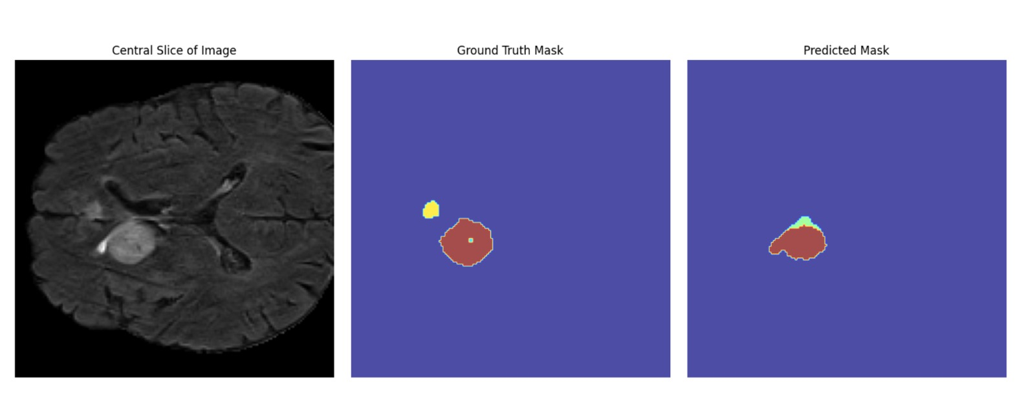
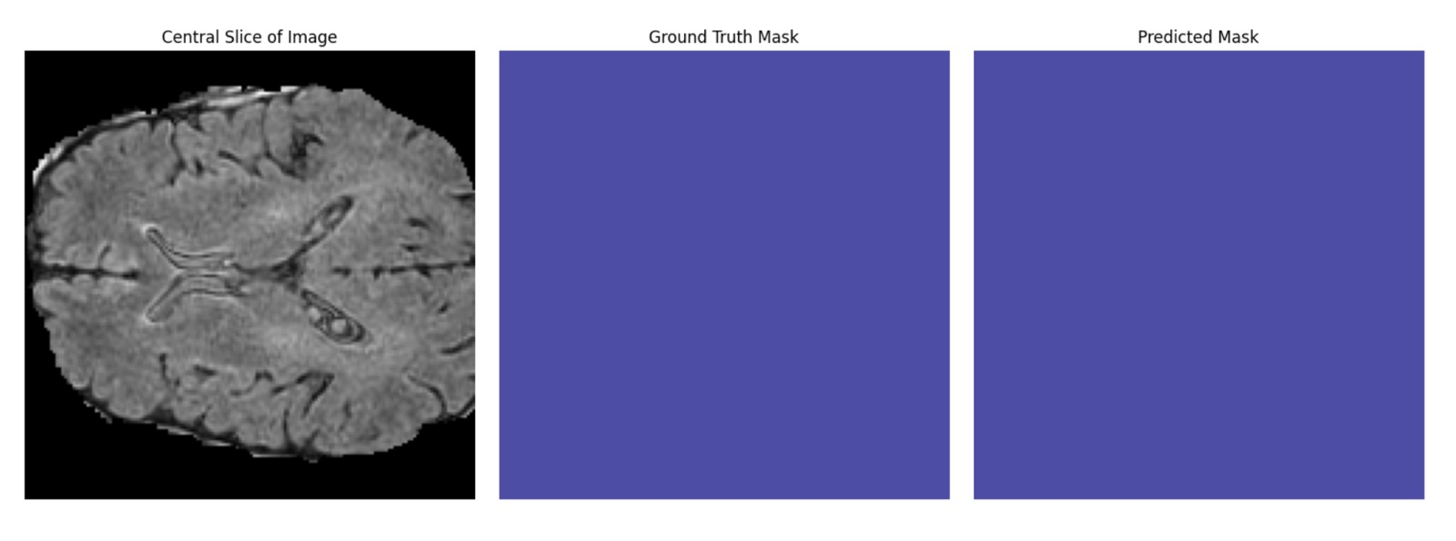
Example Cases

Slide 11
Analytics

Slide 12

Achievements
We Achieved 98.4% Accuracy with 40 epochs
98.8% Accuracy with 1000 epochs – highest so far
Optimized Code for faster training and better performance
Results in 0.07s using GPU and 2.5s on CPU.
Strong Potential: 98.4% accuracy with fewer epochs shows great promise
Breaking the 99% Barrier soon with more resources

Slide 13
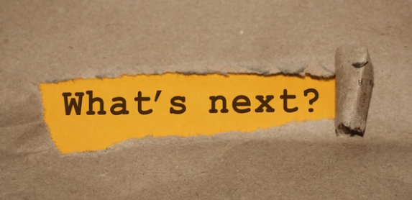
Conclusion & Future Work
Automated Segmentation:
Reduces errors and manual effort.
U-Net: High accuracy in brain tumor segmentation.
Future Work:
Targeting to break the 99% accuracy barrier by next month
Integrate patient history for tumor prediction.
Complete web app for appointments and MRI analysis.
Web App Features:
Appointment System: Book doctor appointments.
MRI Analysis: Upload and analyze MRI scans.
Current Status:
Web app developed and Deployed
Integration with AI Model ongoing.

Slide 14
Acknowledgments
Special Thanks To:
Umme Ummarah
Eisha Tur Razia.
Experts Consulted:
Dr. Faiz Mehmood, Radiology Specialist, NHS, UK.
Dr. Adnan Jaffar, AI Healthcare Specialist, and Professor, Johns Hopkins University, USA.

